Slide 1
HOME AUTOMATION
By
Aniket gourshete

Slide 2
Index
ABOUT ME
INTRODUCTION
MY TAKEAWAYS
MY LEARNINGS
PROJECT INTRODUCTION
PROJECT COMPONENTS
ABOUT COMPONENTS
PROJECT IMPLEMENTATION
CONCLUSION

Slide 3
About me
I’m Aniket Amrut Gourshete, 3rd year student of Electronics & Telecommunications Engineering, studying in Government college of Engineering and Research, Avasari kh.

Slide 4
INTRODUCTION
Technology is evolving everyday becoming an important factor of human life.
Humans never ending desires and needs are the constant motivation for this evolution.
As the pace of life is constantly accelerating, we also need to match up with this
To match this pace we need automation in day to day activities.
This project majorly focuses on automating our day to day homely activities such as controlling garden lights, water tank, cooler and heater.
A mobile application is used to controlling the switches and monitoring the activities.

Slide 5
My takeaways
Technical takeaways
C Programming
IOT Architecture
Arduino module
IOT Cloud Integration
Simulation
Other takeaways
SDLC Process
Time Management
Resume building
Project Implementation

Slide 6
My learnings
This internship has been a constant journey of learnings & knowledge of me
Ever since from the kick-off session, to C programming, IoT introduction and project implementation, with every class I got to learn something new.
IoT was a totally new concept for me but our mentors taught all the details so conveniently.
There are not only technical aspects but other as well. The classes helped me to learn utilizing my time, handling multiple tasks with quality results.
To excel in something application is very important. The regular tests helped me apply my learnings and better understanding
I am deeply grateful to all the mentors, the support team and all the people at Emertxe for such a wonderful opportunity.

Slide 7
Project introduction
Nowadays, we have remote controls for our television sets and other electronic systems, which have made our lives real easy. This project helps the user to control all the electronic devices using his/her smartphone. Time is a very valuable thing
Everybody wants to save time as much as they can. New technologies are being introduced to save our time. To save people's time we are introducing Home Automation system. With the help of this system we can control our home appliances from your mobile phone. You can turn on/off your home appliances with the help of an android application.
The appliances that we will be controlling for this project are Garden lights, Water tank and Temperature system of our home.

Slide 8
Project Components
Hardware
Arduino uno
LDR sensor
Temperature system
CLCD
LEDs
Ethernet
Software
Arduino IDE
PicsimLab
Blynk IOT app

Slide 9
About components
Arduino IDE
used for Arduino programming and defining the functionalities of all the electronic components that we will be using
PicsimLab
Used as an alternative for all the hardware components that we need
Blynk IOT App
Used as a remote control for controlling the appliances remotely through our mobile phone

Slide 10
Project implementation
There are 3 devices that we will be automating. For every device we need to do coding to define smooth functioning, make connections, integrating the device to mobile app, collecting the data and displaying the final output on the lcd and mobile app.
Picsimlab is a software that provides all the necessary devices for our project,
We will be using simulations to get our automation system working.
The 3 utilities that we’ll automate are:
1.Garden lights
2.Temperature system (cooler and heater)
3.Serial Tank

Slide 11
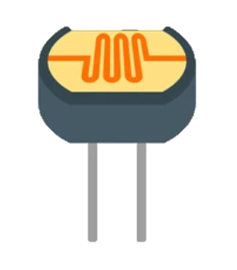
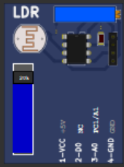
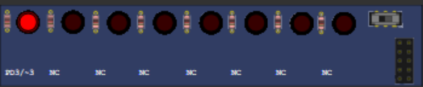
Garden lights
Components used – LDR Sensor, LEDs
1.Light Dependant Resistor - A light-dependent resistor, alternatively called an LDR, photoresistor, photoconductor, or photocell, is a variable resistor whose value decreases with increasing incident light intensity. An LDR is made of a high-resistance semiconductor. If light falling on the device is of high enough frequency, photons absorbed by the semiconductor give bound electrons enough energy to jump into the conduction band. The resulting free electron (and its hole partner) conduct electricity, thereby lowering resistance.
2. Light Emitting Diodes - A light-emitting diode (LED) is a semiconductor device that emits light when current flows through it. Electrons in the semiconductor recombine with electron holes, releasing energy in the form of photons. Here we will use LED as garden lights

Slide 12
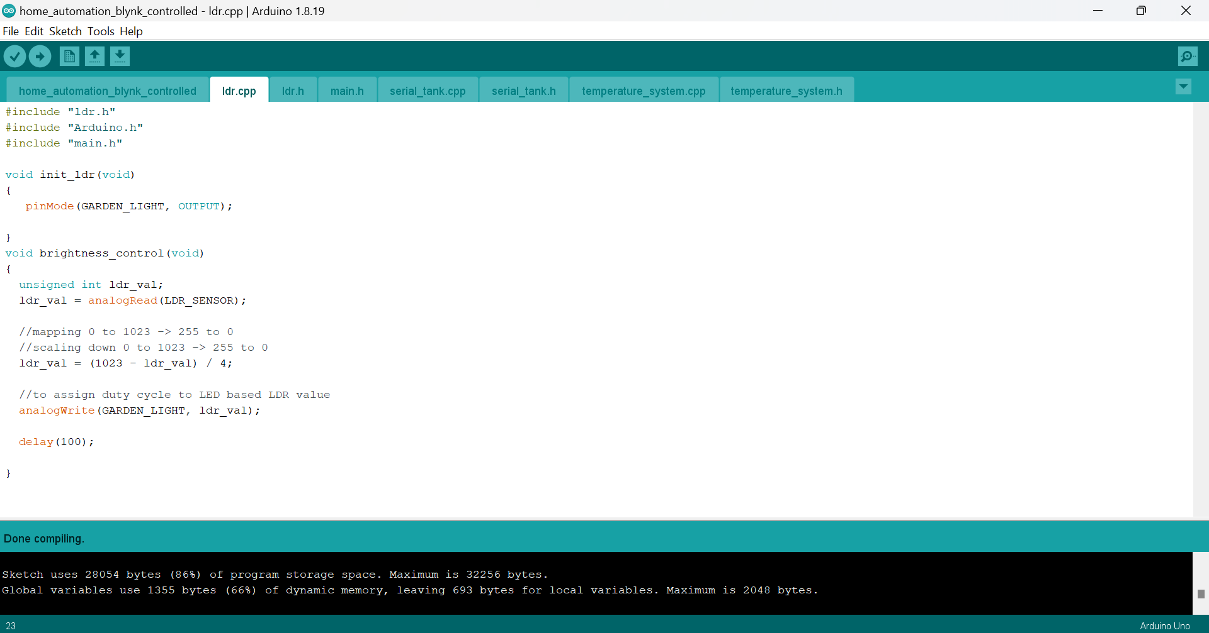
Coding
To make the garden work smoothly, we need to define a function brightness_control() with no parameters.
The following formula helps control the brightness of the LED as the Value of LDR decreases
ldr_val = (1023 - ldr_val) / 4;
As the light falling on the resistor decreases the LEDs begin to brighten.
Connections
LDR connected at A1 pin of Arduino uno
LED is connected at pin 3

Slide 13
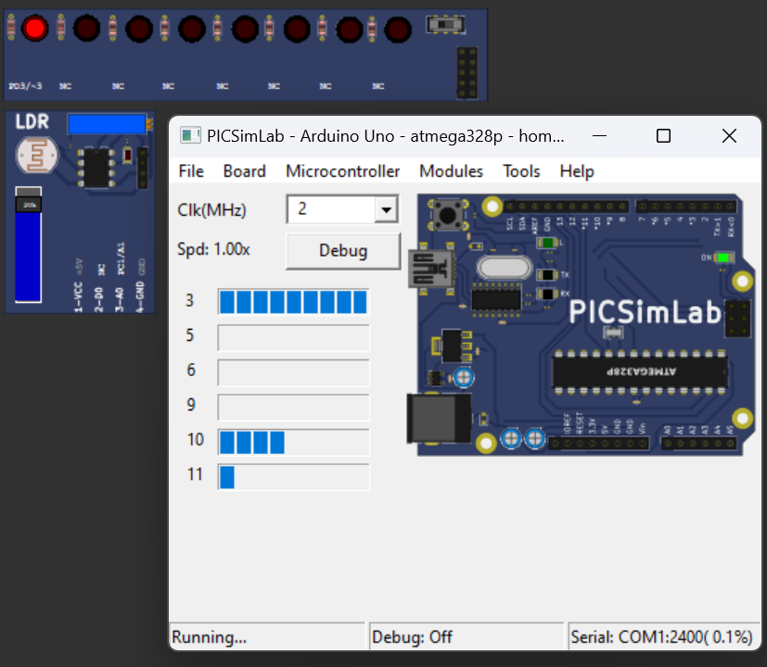
Final output
When we turn on the power the system starts working and we can see the brightness of LEDs increasing/decreasing as we increase/decrease the inputs on the LDR

Slide 14
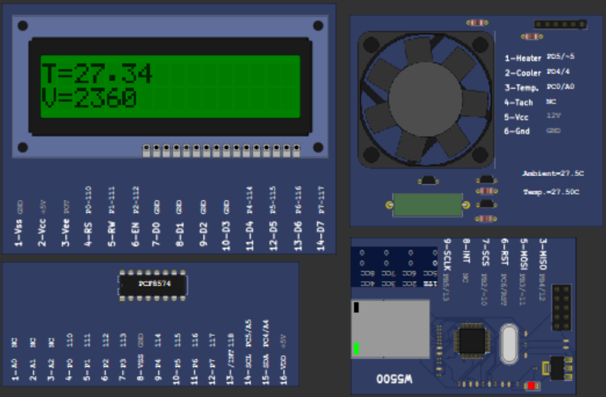
Temperature system
Components – Temperature system, CLCD, Ethernet
1. Temperature System – A virtual system with cooler, heating resistor, LM35 temperature sensor and built in tachometer.
2. CLCD – LCD screen to display temperature and heater/cooler on/off status.
3. Ethernet – To establish connection between mobile app & hardware in this case simulation environment

Slide 15
Coding
We define following functions:
1. init_temperature_system() – to initialize the system
2. read_temperature() – to read and display the temperature value on CLCD
3. cooler_control() – to turn on/off the cooler
4. heater_control() – to turn on/off the heater
5. handle_temp() – to set a threshold temperature value and turn off the heater when temperature exceeds 35 degree Celsius
6. BLYNK_WRITE(COOLER_V_PIN) – to control and modify on/off status of cooler through mobile
7. BLYNK_WRITE(HEATER_V_PIN) – to control and modify on/off status of heater through mobile
8. update_temperature_reading() – to display temperature on gauge widget on blynk app

Slide 16
Connections
For CLCD
SCL at A5
SDA at A4
For Temperature system
Heater at pin 5
Cooler at pin 4
Temperature sensor at A0
For Ethernet
MISO at 12
MOSI at 11
RESET at RESET
SCS at 10
SCLK at 13

Slide 17
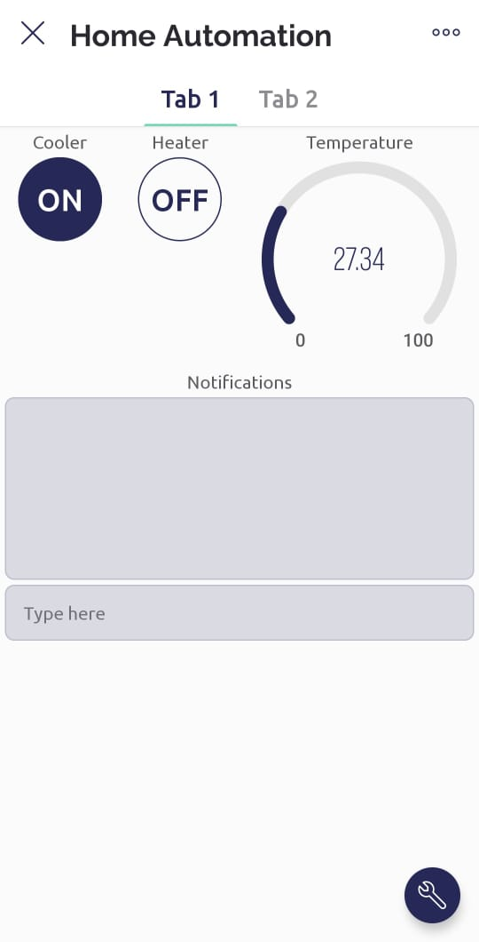
Cloud integration –
We need to create virtual pins on blynk cloud datastreams, buttons, gauges and a notification panel to control heater and cooler, display temperature and show status of threshold temperature respectively.
2 ON/OFF buttons, a temperature gauge and a notification panel is created in blynk application and are kept on a separate tab.

Slide 18
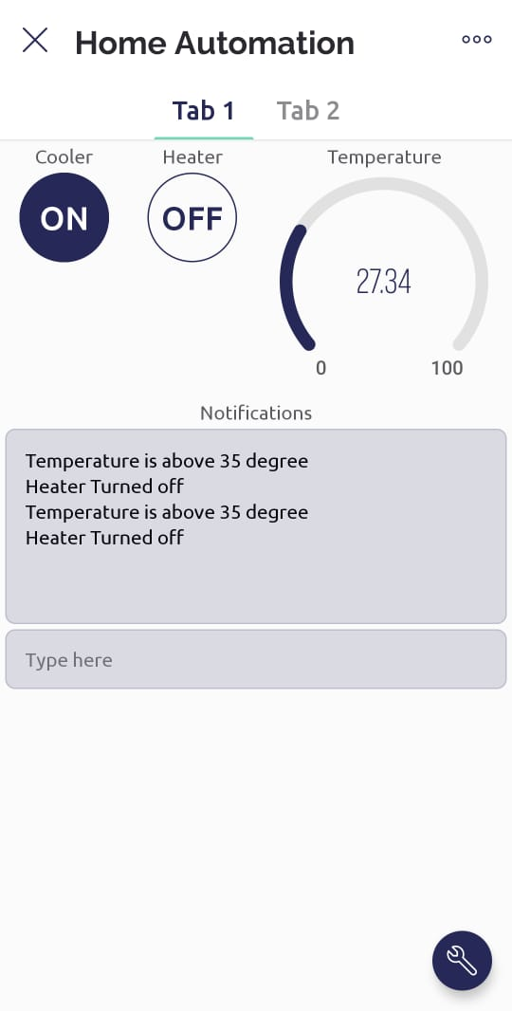
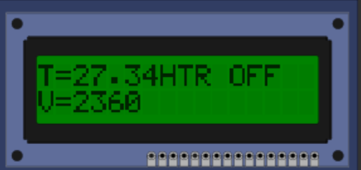
Final output – Here we can clearly see the lcd screen showing temperature value and heater off status.
On the blynk app interface we can see heater button turned off, temperature gauge showing the temperature value and the notification bar showing threshold value being reached

Slide 19
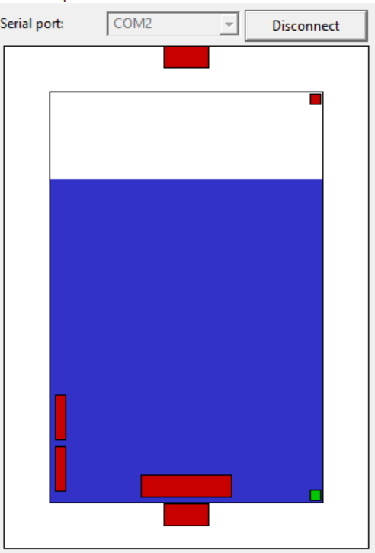
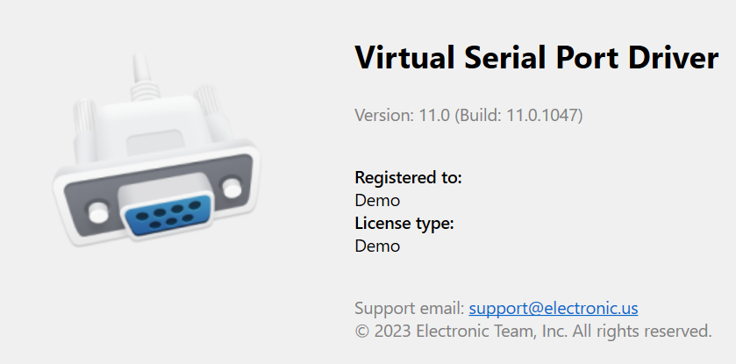
Serial tank
Components – Serial tank, CLCD, Ethernet, VSPDS
Serial tank - The serial remote tank is a tank simulator controlled by a serial communication protocol. The tank has several sensors and actuators that can be read and controlled using the communication protocol.
Virtual serial port drivers – to establish connection between serial tank and Arduino module through serial ports
CLCD – to display volume of water and status of Inlet/Outlet valve
Ethernet – to establish connection between mobile app and simulation environment

Slide 20
Coding –
We define following functions:
init_serial_tank() – to initialize the tank
enable_outlet() – to enable the outlet valve
enable_inlet() – to enable the inlet valve
disable_inlet() – to disable to inlet valve
disable_outlet – to disable outlet valve
handle_tank() – to set threshold volume value and turn on the inlet valve when volume reduces below 2000ltrs
Volume() – to read the volume contained in the tank
BLYNK_WRITE(INLET_V_PIN) – to control and modify on/off status of inlet valve through mobile
BLYNK_WRITE(OUTLET_V_PIN) – to control and modify on/off status of outlet valve through mobile
Update_temperature_reading() – to update the value of volume every 0.5 secs on volume gauge on blynk app

Slide 21
Connections
For CLCD
SCL at A5
SDA at A4
For Serial tank
COM2 at COM1 serial port
For Ethernet
MISO at 12
MOSI at 11
RESET at RESET
SCS at 10
SCLK at 13

Slide 22
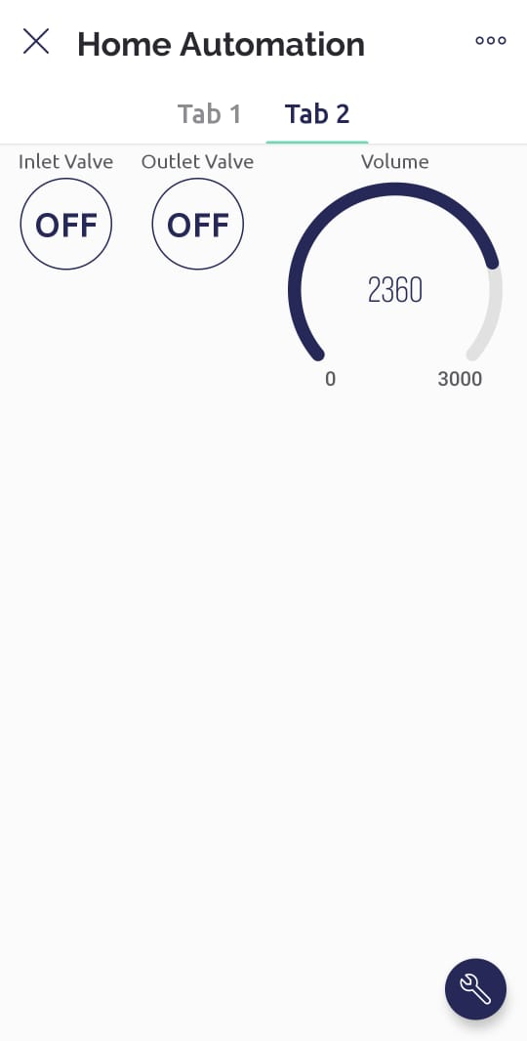
Cloud Integration -
We need to create virtual pins on blynk cloud datastreams, buttons, gauges and a notification panel to control inlet and outlet valve, display volume and show status of threshold volume respectively.
2 ON/OFF buttons, a volume gauge and a notification panel is created in blynk application and are kept on a separate tab.

Slide 23
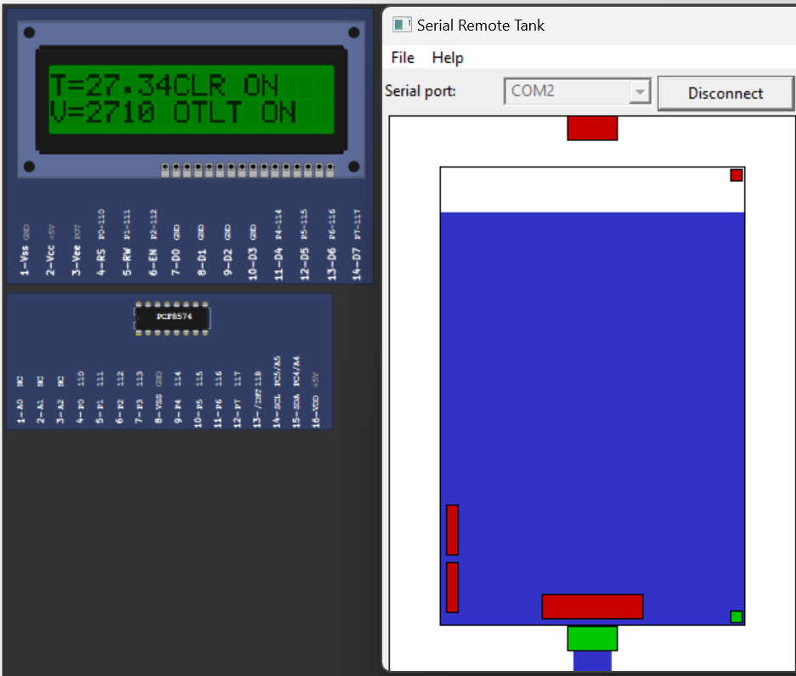
Final output – the lcd screen showing volume in the tank, on status of outlet valve. And the blynk screen showing volume gauge and 2 buttons

Slide 24
conclusion
During this training internship programme we developed this user friendly, efficient & sustainable Home Automation system.
The system widely aims to a fast, reliable and better life style.
The remotely controllable application makes the system more usable and
easy going.

